Slide 1







Popular Front-End Libraries
Bootstrap, Slick Slider, Sweet Alert, Animate.css, Hover.css
Popular Front-End
Libraries
SoftUni Team
Technical Trainers
Software University
http://softuni.bg

Slide 2
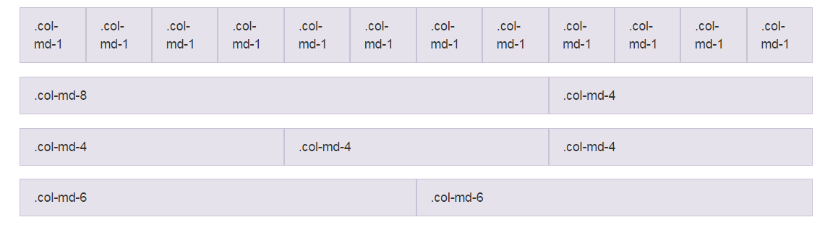





Table of Contents
Bootstrap
Slick Slider
Animate CSS
Hover CSS
Sweet Alerts

Slide 3

Have a Question?
sli.do #html-softuni

Slide 4

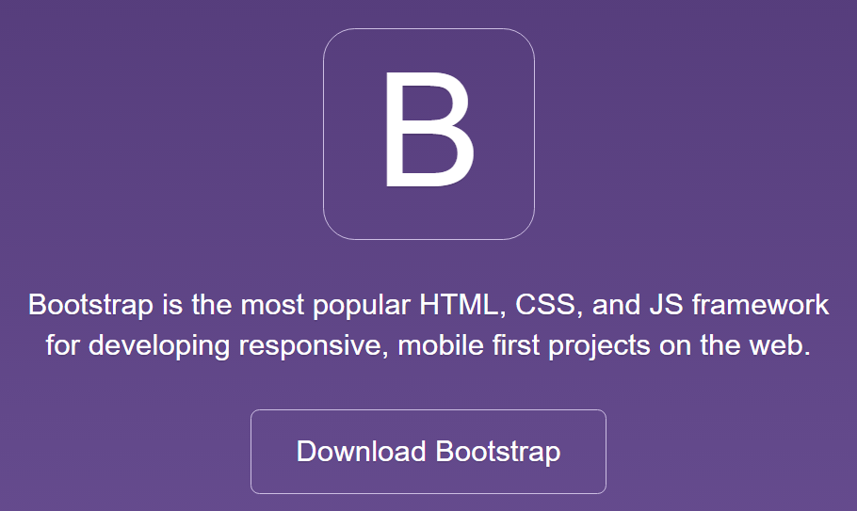


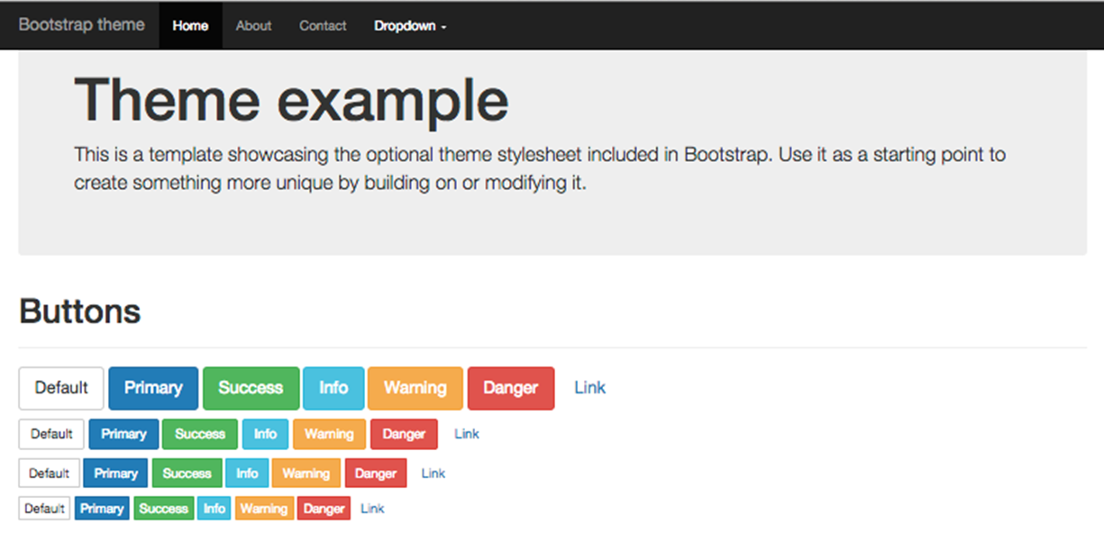
Bootstrap
Introduction

Slide 5
What is Bootstrap?
Bootstrap is a front-end framework for responsive Web sites
Responsive sites made easy
Built on 12-column grid system
Manages most of your UI: typography, lists, tables, forms, buttons, images, navigations, alerts, pagination, panels, etc.
Official site: http://getbootstrap.com

Slide 6
Bootstrap Features
Grid system
12-column fluid grid system for phones / tablets / desktops
Predefined UI design CSS styles for the most page elements
Typography: headings, subheadings, fonts, colors, lists, etc.
Tables, forms and controls, buttons, image shapes, etc.
Components
Glyph icons, dropdowns, button groups, input groups, tabs, navigation bars (site headers), breadcrumps, pagers, labels, badges, jumbotrons (showcases), thumbnails, alerts, list groups, …

Slide 7
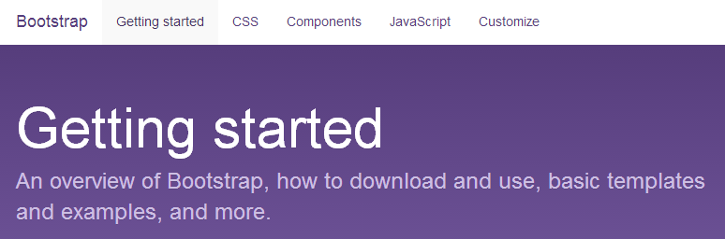
Bootstrap
Getting Started

Slide 8
Getting Started with Bootstrap
Download Bootstrap from:
http://getbootstrap.com/getting-started/#download
Creating and Bootstrap-based HTML page:
<head>
<link href="css/bootstrap.min.css" rel="stylesheet">
<script src="https://code.jquery.com/jquery-3.2.1.min.js"></script>
<script src="js/bootstrap.min.js"></script>
</head>
<body> … </body>

Slide 9
Bootstrap Grid System
Containers
Rows
Columns: xs (phone), sm (tablet), md (laptop), lg (desktop)
<div class="container">
<div class="fluid-container">
<div class="row">
<div class="row hidden-xs">
<div class="col-sm-6 col-md-9">
<div class="col-sm-12 col-md-6 col-lg-9">

Slide 10
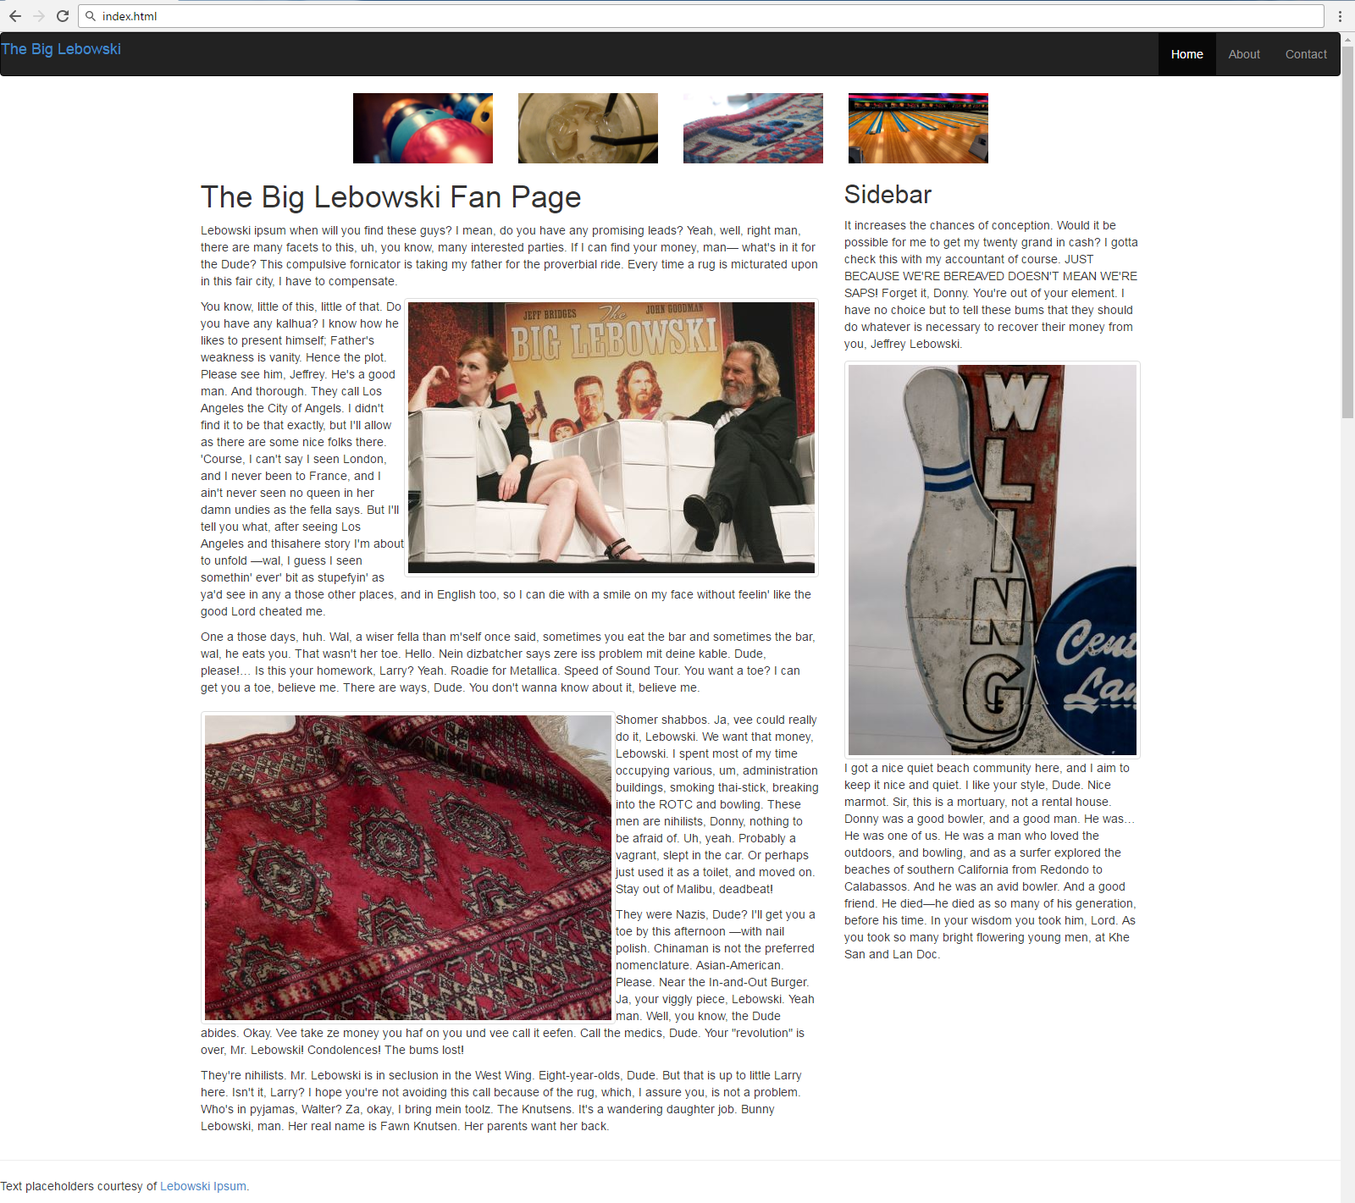
Problem: Bootstrap Page

Slide 11
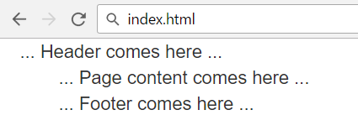
Solution: Bootstrap Page – Skeleton
<link rel="stylesheet" href="css/bootstrap.min.css">
<script src="https://code.jquery.com/jquery-3.2.1.min.js"></script>
<script src="js/bootstrap.min.js"></script>
<header class="container-fluid">
… Header comes here …
</header>
<main class="container">
… Page content comes here …
</main>
<footer class="container">
… Footer comes here …
</footer>

Slide 12
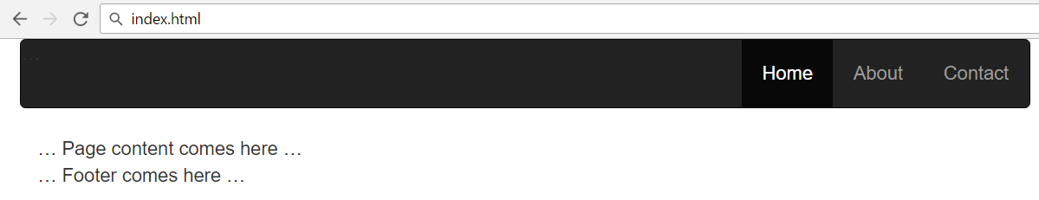
Solution: Bootstrap Page – Header
Holds the mobile menu toggle icon (for small screens)
<header class="container-fluid">
<nav class="navbar navbar-inverse">
<div class="navbar-header">…</div>
<div class="navbar-collapse collapse">
<ul class="nav navbar-nav navbar-right">
<li class="nav active"><a href="#">Home</a></li>
<li class="nav"><a href="#">About</a></li>
<li class="nav"><a href="#">Contact</a></li>
</ul>
</div>
</nav>
</header>

Slide 13
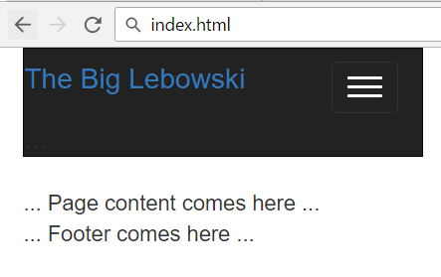
Solution: Bootstrap Page – Header (2)
<div class="navbar-header">
<button class="btn btn-success navbar-toggle"
data-toggle="collapse" data-target=".navbar-collapse">
<span class="icon-bar"></span>
<span class="icon-bar"></span>
<span class="icon-bar"></span>
</button>
<div>
<a href='#'><h4>
The Big Lebowski</h4></a>
</div>
</div>

Slide 14
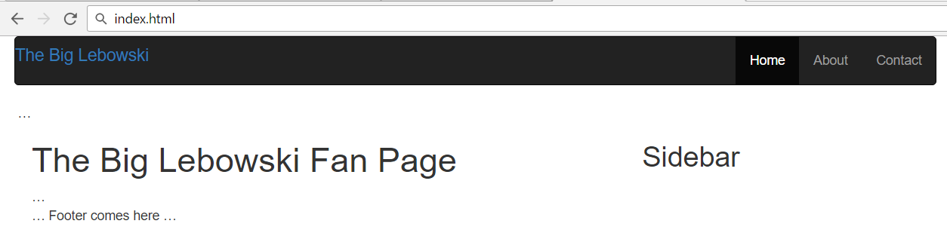
Solution: Bootstrap Page – Main Layout
<main class="container">
<div class="row visible-md visible-lg">…</div>
<div class="row">
<div class="col-md-8 col-sm-9">
<h1>The Big Lebowski Fan Page</h1>
…
</div>
<aside class="col-md-4 col-sm-3">
<h2>Sidebar</h2>
…
</aside>
</div>
</main>

Slide 15
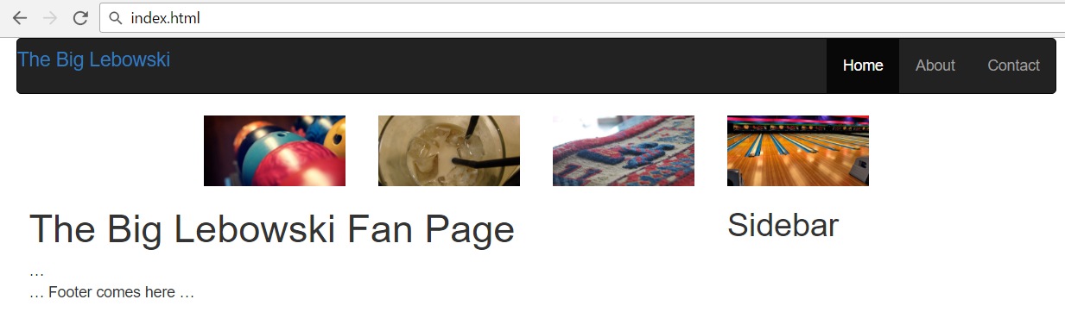
Solution: Bootstrap Page – Carousel
<main class="container">
<div class="row visible-md visible-lg">
<img src="images/carousel-1.jpg"
class="col-md-2 col-md-offset-2">
<img src="images/carousel-2.jpg" class="col-md-2">
<img src="images/carousel-3.jpg" class="col-md-2">
<img src="images/carousel-4.jpg" class="col-md-2">
</div>
…
</main>

Slide 16
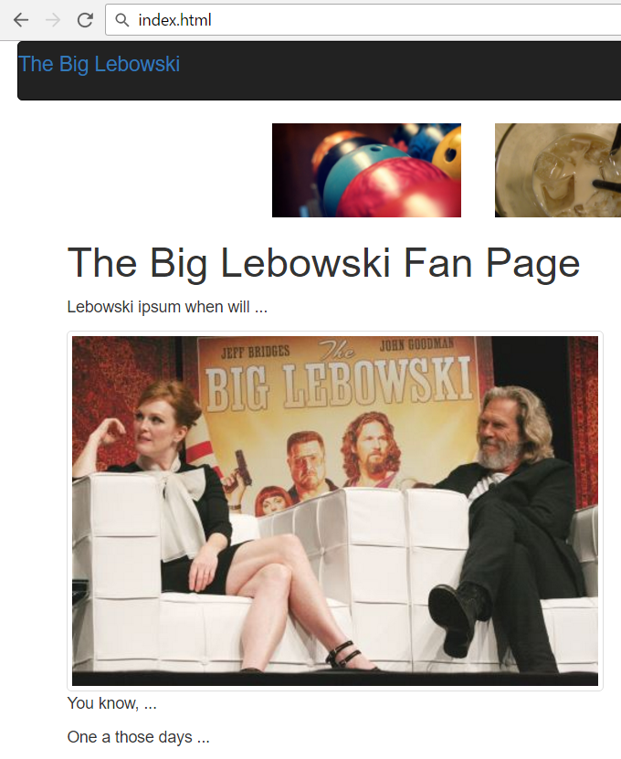
Solution: Bootstrap Page – Main Content
<div class="col-md-8 col-sm-9">
<h1>The Big Lebowski Fan Page</h1>
<p>Lebowski ipsum when will …</p>
<img src="images/lebowski-1.jpg"
class="pull-right img-thumbnail" />
<p>You know, …</p>
<p>One a those days …</p>
<img src="images/lebowski-3.jpg"
class="pull-left img-thumbnail" />
<p>Shomer shabbos …</p>
<p>They were Nazis …</p>
<p>They're nihilists …</p>
</div>

Slide 17
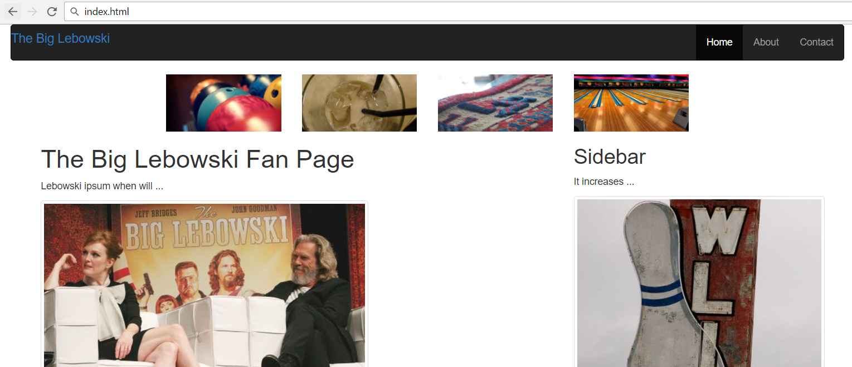
Solution: Bootstrap Page – Sidebar
<aside class="col-md-4 col-sm-3">
<h2>Sidebar</h2>
<p>It increases …</p>
<img src="images/lebowski-2.jpg" class="img-thumbnail pull-right"/>
<p>I got a nice … </p>
</aside>

Slide 18
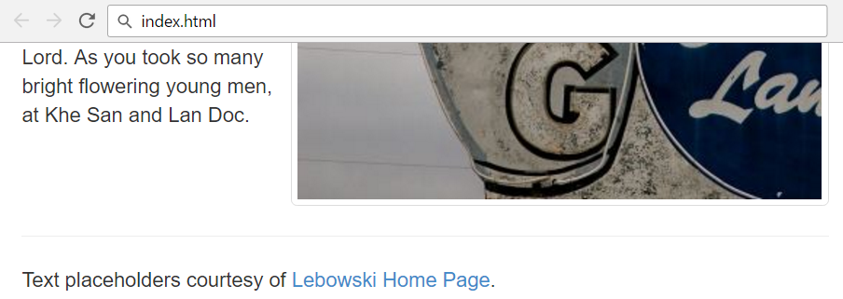
Solution: Bootstrap Page – Footer
<footer class="container">
<hr />
<p>Text placeholders courtesy of <a href="#">Lebowski
Home Page</a>.</p>
</footer>

Slide 19
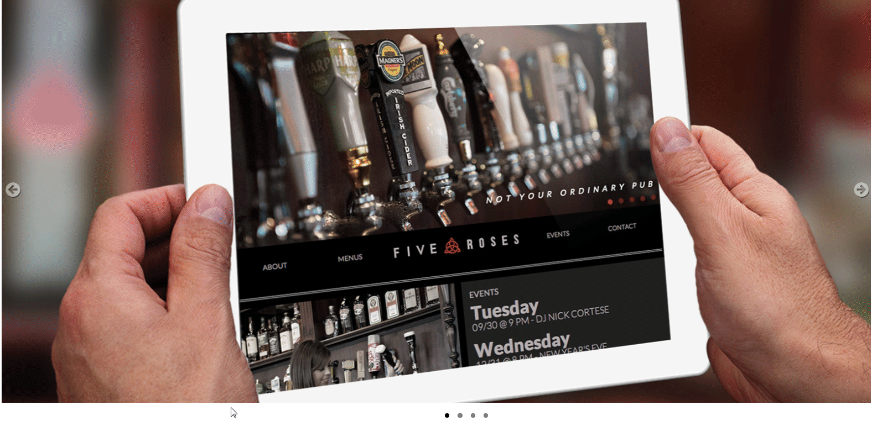
Slick Slider

Slide 20
Problem: Slick Slider
You are given a HTML page holding 4 images
Display them as image slider

Slide 21
Solution: Slick Slider
First, import the Slick Slider library (CSS + JS files)
<link rel="stylesheet" type="text/css"
href="https://cdn.jsdelivr.net/jquery.slick/1.6.0/slick.css"/>
<script src="jquery-3.1.1.min.js"></script>
<script type="text/javascript"
src="https://cdn.jsdelivr.net/jquery.slick/1.6.0/slick.min.js">
</script>
<link rel="stylesheet"
href="https://maxcdn.bootstrapcdn.com/font-awesome/4.7.0/css/font-awesome.min.css">
<link rel="stylesheet" href="styles/styles.css">

Slide 22
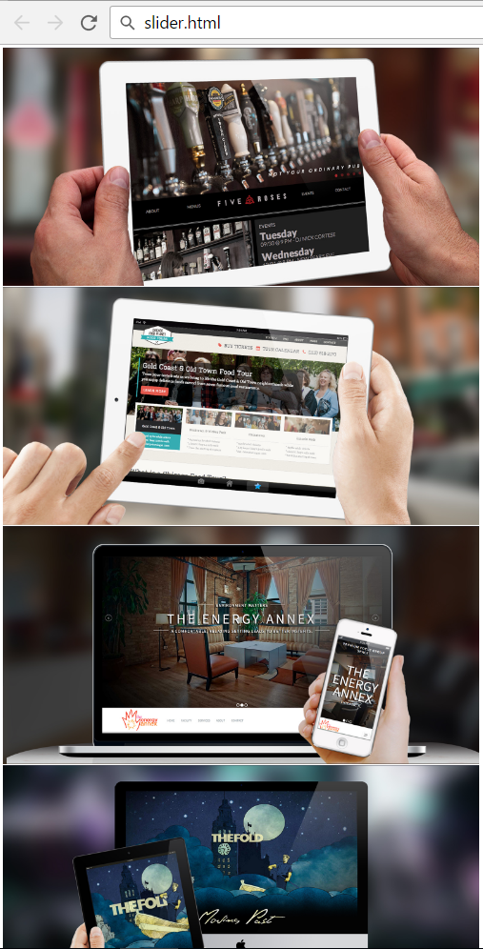
Solution: Slick Slider – HTML
Display the image container, holding the images in <div> elements:
<div class="slider">
<div><img src="img/FiveRosesPub_Web1.jpg"
alt="Img #1</div>
<div><img src="img/FoodTours_Web.jpg"
alt="Img #2"></div>
<div><img src="img/TheEnergyAnnex_Web.jpg"
alt="Img #3"></div>
<div><img src="img/TheFold_Web1.jpg"
alt="Img #4"></div>
</div>

Slide 23

Solution: Slick Slider – Pager
Display the image pager (holding 4 pages):
<ol class="slider-nav-thumbnails
flex-control-paging">
<li>1</li>
<li>2</li>
<li>3</li>
<li>4</li>
</ol>

Slide 24
Solution: Slick Slider – Script Code
The JavaScript code configures the slider:
<script>
$('.slider').slick({
slidesToShow: 1,
slidesToScroll: 1,
arrows: false,
fade: false,
asNavFor:
'.slider-nav-thumbnails',
});
$('.slider-nav-thumbnails')
.slick({
slidesToShow: 4,
slidesToScroll: 1,
asNavFor: '.slider',
dots: true,
focusOnSelect: true
});
</script>

Slide 25

Animate.css

Slide 26
Problem: Animate CSS
Create page like the following
The animations start when the page is loaded

Slide 27
Solution: Animate CSS
<link rel="stylesheet" href="css/bootstrap.min.css">
<link rel="stylesheet" href="https://cdnjs.cloudflare.com/ajax/libs/animate.css/3.5.2/animate.min.css">
<script src="js/jquery-3.1.1.min.js"></script>
<script src="js/bootstrap.min.js"></script>
<div class="container">
<div class="row">
<h2 class="text-center">Common Question</h2>
<article class="col-sm-6 col-md-4 animated slideInLeft">
<h3>Who Are Your Clients?</h3>
<p">Our clients range from talent…</p>
</article>
<!-- Put the next animated article here -->

Slide 28
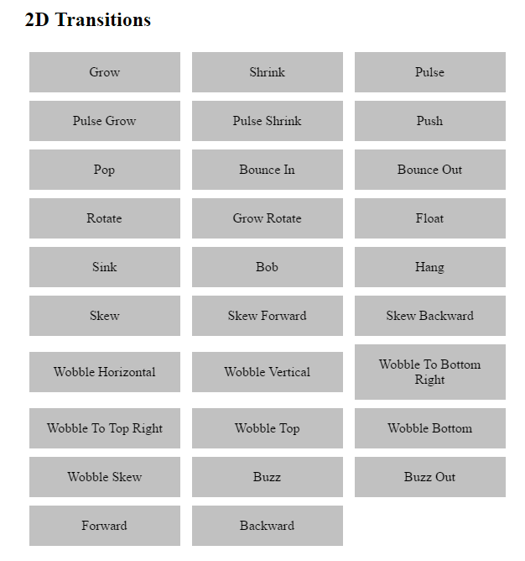
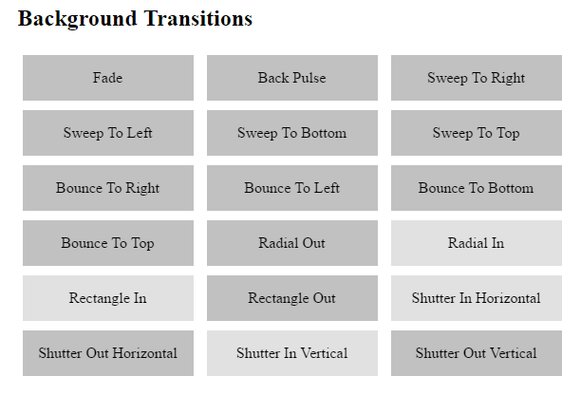
Hover.css

Slide 29
Hover CSS
Download Hover.css
https://github.com/IanLunn/Hover/blob/master/css/hover-min.css
Add hover.css to your project
Play with it (add .hvr-something class)
<link rel="stylesheet" href="css/hover-min.css">
button {
display: inline-block;
…
}
<a href="#" class="button hvr-grow">
Grow
</a>

Slide 30
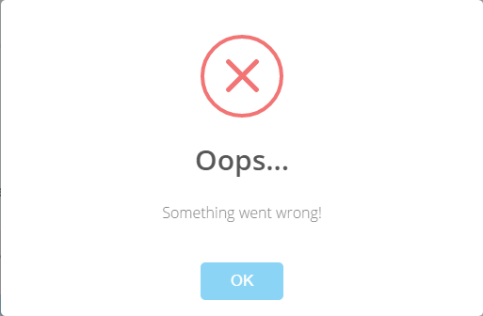
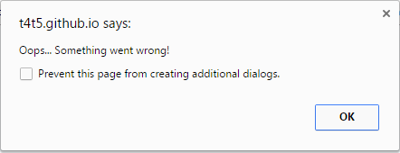
Sweet Alert
vs.

Slide 31
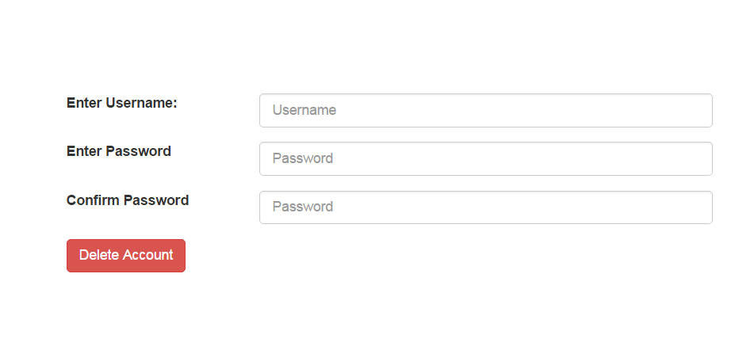

Problem: Sweet Alert
Download the Sweet Alert library
You are given an HTML file
Include the missing CSS and scripts files
Write the missing JavaScript code

Slide 32
Solution: Sweet Alert
Include the "Bootstrap" and "Sweet Alert" JS library to your HTML site:
<link rel="stylesheet" href="css/bootstrap.min.css">
<link rel="stylesheet" href="dist/sweetalert.css">
<script src="js/jquery-2.0.3.min.js"></script>
<script src="js/bootstrap.min.js"></script>
<script src="dist/sweetalert.min.js"></script>

Slide 33
Solution: Sweet Alert
<script>
$('.btn').click(() => {
swal({ title: "Are you sure?", type: "warning",
text: "You will not be able to recover your account!",
showCancelButton: true,
confirmButtonColor: "#DD6B55",
confirmButtonText: "Yes, delete it!",
closeOnConfirm: false
},
function() { swal("Deleted!", "Your account …","success"); }
);
});
</script>

Slide 34


Summary
Bootstrap CSS framework
Powerful 12-column grid system
Slick Slider
Easy to use slider library
Animate CSS
CSS animation library
Hover CSS
CSS hover library
Sweet Alerts
JS alerts library

Slide 35








Popular Front-End Libraries
https://softuni.bg/courses/web-fundamentals-html5

Slide 36
License
This course (slides, examples, demos, videos, homework, etc.) is licensed under the "Creative Commons Attribution-NonCommercial-ShareAlike 4.0 International" license

Slide 37




Free Trainings @ Software University
Software University – High-Quality Education, Profession and Job for Software Developers
softuni.bg
Software University Foundation
softuni.org
Software University @ Facebook
facebook.com/SoftwareUniversity
Software University Forums
forum.softuni.bg

